Slide 1

Elective Selection Orientation Supply Chain Management
24.06.2023
Academic Year :2023-24
Department of Mechanical Engineering
Venkadeshwaran K
Associate Professor/MECH

Slide 2
SCM objetives and outcomes
The objective of the course is to impart knowledge and competencies for:
Recognising supply chain integration to support products in various product life cycle.
Leveraging organisational capabilities and resources across supply chain business processes.
Designing lean but agile supply chains that integrate green initiatives.
Implementing e-supply chains management systems.
On completion of the course the student will be able to:-
CO1: Illustrate fundamentals of supply chain management and logistics concepts.
CO2: Choose appropriate logistics strategies required for the successful supply chain.
CO3: Schedule for efficient usage of resources and smooth material flow management.
CO4: Employ methods for synchronous and sustainable supply chain.
CO5: Appraise the barriers and future of supply chain management.
CO6: Formulate system requirements for the management of a supply chain with corporate goals and strategies.

Slide 3
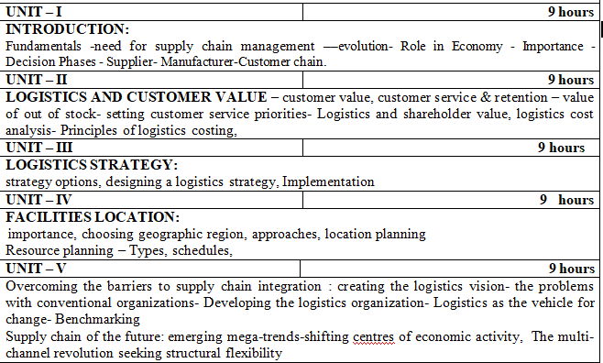
Syllabus

Slide 4
Business processes
Business processes
Purchasing
Production
Financing
Financing
Marketing

Slide 5
Why SCM?
Attainment of sub-optimal goals
Duplication of efforts
Inefficient usage of resources
Lack of efficiency, effective coordination and in business processes

Slide 6
Supply Chain
A supply chain is referred to as an integrated system that synchronizes a series of interrelated business processes in order to).
create demand for products
add value to these products
distribute and promote these products
transform these raw materials and parts into finished products
facilitate information exchange among various business entities
acquire raw materials and parts

Slide 7
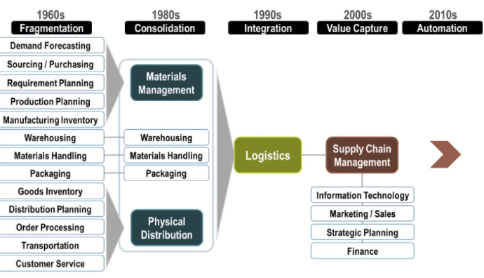
Evolution of Supply chain

Slide 8
Learning Artefacts
Samples of teaching artefacts for the course –Supply Chain Management
Sl.No | Type of Artefact | Link
1 | PowerPoint Presentations & Study Materials | Google Classroom
2 | Videos( Back up videos of the classes & relevant concept videos ) | Google Classroom
3 | Case Study | Google Classroom
4 | LinkedIn | Google Classroom
5 | NPTEL videos | Google Classroom

Slide 9
Mapping of Courses to Subjects Projects
Entreprenuership area | Mini Projects | Major projects | Capstone projects
Solar Panel Building and Installation. | 1.Report on business opportunities for Solar energy based products | Projects related to computation of solar panel installation requirements for residential/ commerical buildings Fabrication of solar panel based utilities and evaluating the performance Formulate a SCM implementation model for a solar panel installation company | Writing a complete business plan for a solar installation startup
Mapped Courses | 1.Engineering Mechanics 2.Engineering Materials 3.English for Technical Writing | Production Planning and Control Total Quality Management Supply Chain Management Wind and solar energy
Learning Outcome | Demonstrate conceptual clarity about Solar related businesses Use effectively oral, written and visual communication. Integrate information from multiple sources. | Demonstrate knowledge and understanding of the engineering and management principles and apply these to manage projects, identify business opportunities & sources of finance. Demonstrate skill and knowledge of current information and technological tools and techniques specific to hybrid cars | Demonstrate an awareness and application of appropriate personal, societal, and professional ethical standards. Demonstrate ability to comprehend and write effective reports, design documentation and make effective presentations,

Slide 10
Assessment Instruments
Case Discussion
Technical Seminar/ Voice over PPT
Assignment
Group Discussion
Review report

Slide 11
Skill set required and mapping
Skill set required
Project management.
Technical understanding.
Understanding of e-business / e-procurement systems
Troubleshooting, problem solving.
Skill sets mapped
Mini Project
Technical understanding.
(Unit 1 to 4)
Understanding of e-business / e-procurement systems
(Unit 5 activities)
Troubleshooting, problem solving.
(Unit 5 activities)

Slide 12
Interactivity & Use of Technology for Teaching
Google Classroom
Zoom Sessions
Slide Show/ PPT
Virtual Sessions
Tool Based Learning
Blended Learning
Flipped Class room

Slide 13
THANK YOU

